Slide 1
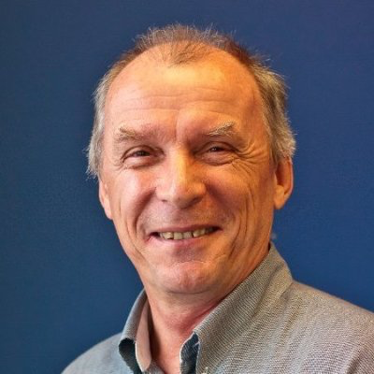
Department of Environmental Science Seminar Series
Dr Klaus koop
FACULTY OF science and engineering
Successful university-government research partnerships
Dr Klaus Koop
Director, Environmental Protection Branch
Science Division, NSW Office of Environment and Heritage.
Board member of the Environmental Trust and recipient of the Australian Public Service Medal.
Building E5A130, 1pm, Tuesday September 1st

