Slide 1
International Research Collaborations
JOINT SUPERVISION PROGRAMS

Slide 2
World-Leading Research World-Changing Impact
Key objective 2:
Prepare world-ready higher degree research candidates

Slide 3
Cotutelle & Joint PhD
FACT & FIGURES
JOINT ENROLMENT AT TWO
OR MORE UNIVERSITIES
89 COTUTELLE/JOINT PHD
CANDIDATES CURRENTLY
ENROLLED
225 COTUTELLE/JOINT
PHD CANDIDATES SINCE THE
PROGRAMS INCEPTION
PARTNER UNIVERSITIES IN
OVER 30 COUNTRIES – LED
BY EUROPE AND CHINA
SCIENCE AND ENGINEERING
HAVE THE MOST CANDIDATES
JOINT SUPERVISION PROGRAMS
ARE PART OF OUR STRATEGIC
RESEARCH FRAMEWORK FROM
2015 - 2024

Slide 4
Cotutelle and Joint PhD by countries and regions

Slide 5
Cotutelle & Joint PhD
FACT & FIGURES
Arts
50 student (22.22%)
Business and Economics
20 students (8.89%)
Science and Engineering
100 Students (44.45%)
Medicine and Health
1 student (0.45%)
Human Sciences
54 students (24%)

Slide 6
Why do we do it?
Establishing deep and continuing relationships
Institutions | Candidate
Deepens and strengthens research collaborations and networks at an institutional level | Exposure to different academic environments through joint enrolment and supervision
Fosters a higher level of cooperation between researchers in their respective fields through co-supervision | Training experiences and access to the latest research equipment and technologies at two institutions
Provides access to new funding schemes as well as new international enrolments | International networking opportunities that will expand future employment opportunities through exposure to new academic institutions and new industries
Provides an opportunity to increase joint publications, citation rate and rankings | Access to new funding schemes
Make the institution more attractive to potential candidates | Experience a new culture and environment and develop soft skills

Slide 7
Program Management Systems
Cotutelle & Joint PhD

Slide 8
Joint Supervision
Candidate Management
Cotutelle/Joint PhD Management Guide
Research Master & AMIS Databases
Cotutelle & Joint PhD Research Management Workshop

Slide 9
Cotutelle & Joint PhD
What’s the difference?

Slide 10
Cotutelle | Joint PhD
Joint enrolment at MQ and an overseas university | Joint enrolment at MQ and an overseas university
Priority institutional partners – but open to all universities subject to approval | Institutional partners require Academic Senate Approval
Institutional memorandum of understanding (MOU) not compulsory | Institutional MOU/agreement required
Separate progress assessments | One university is designated as the lead
Single thesis submitted to both universities | Single thesis submitted to the lead university
Separate Examination | Joint examination
Two testamurs | One joint testamur
Two graduation ceremonies | One graduation ceremony

Slide 11
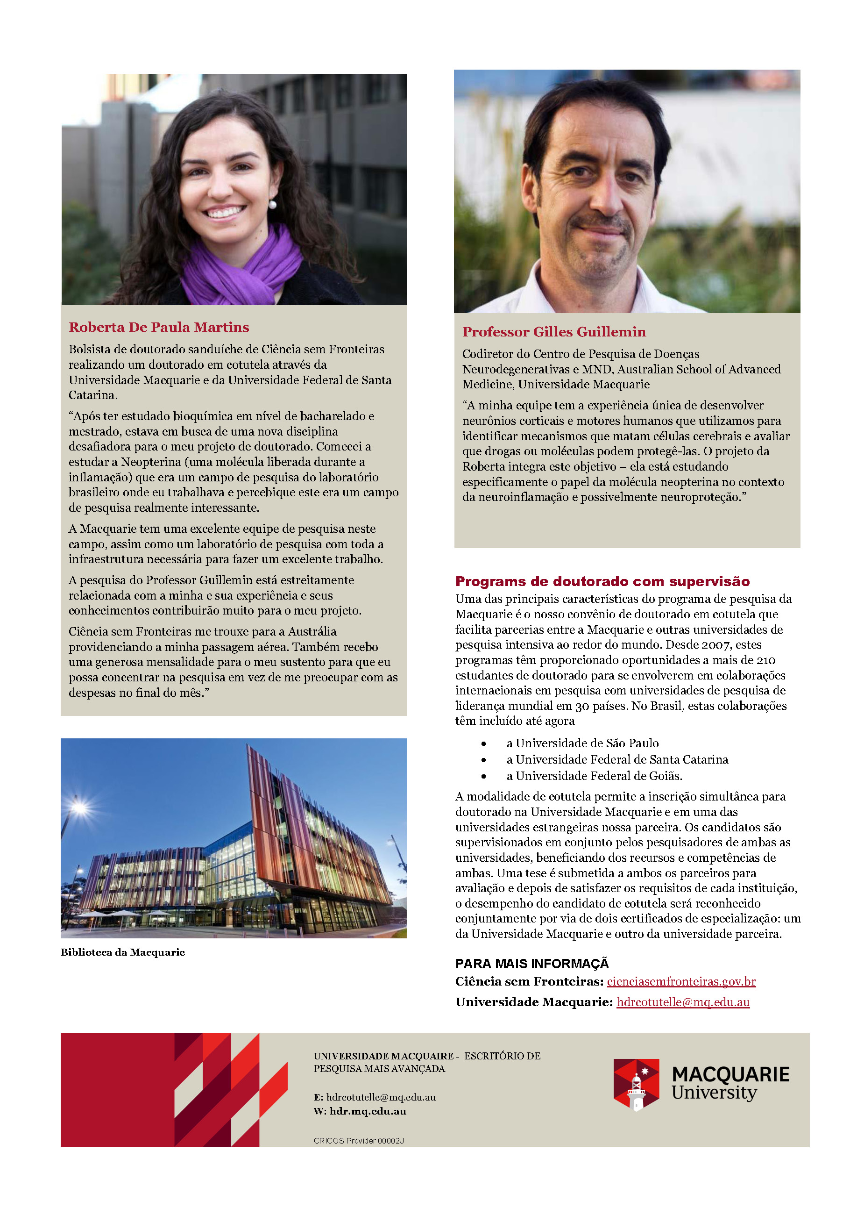

Slide 12
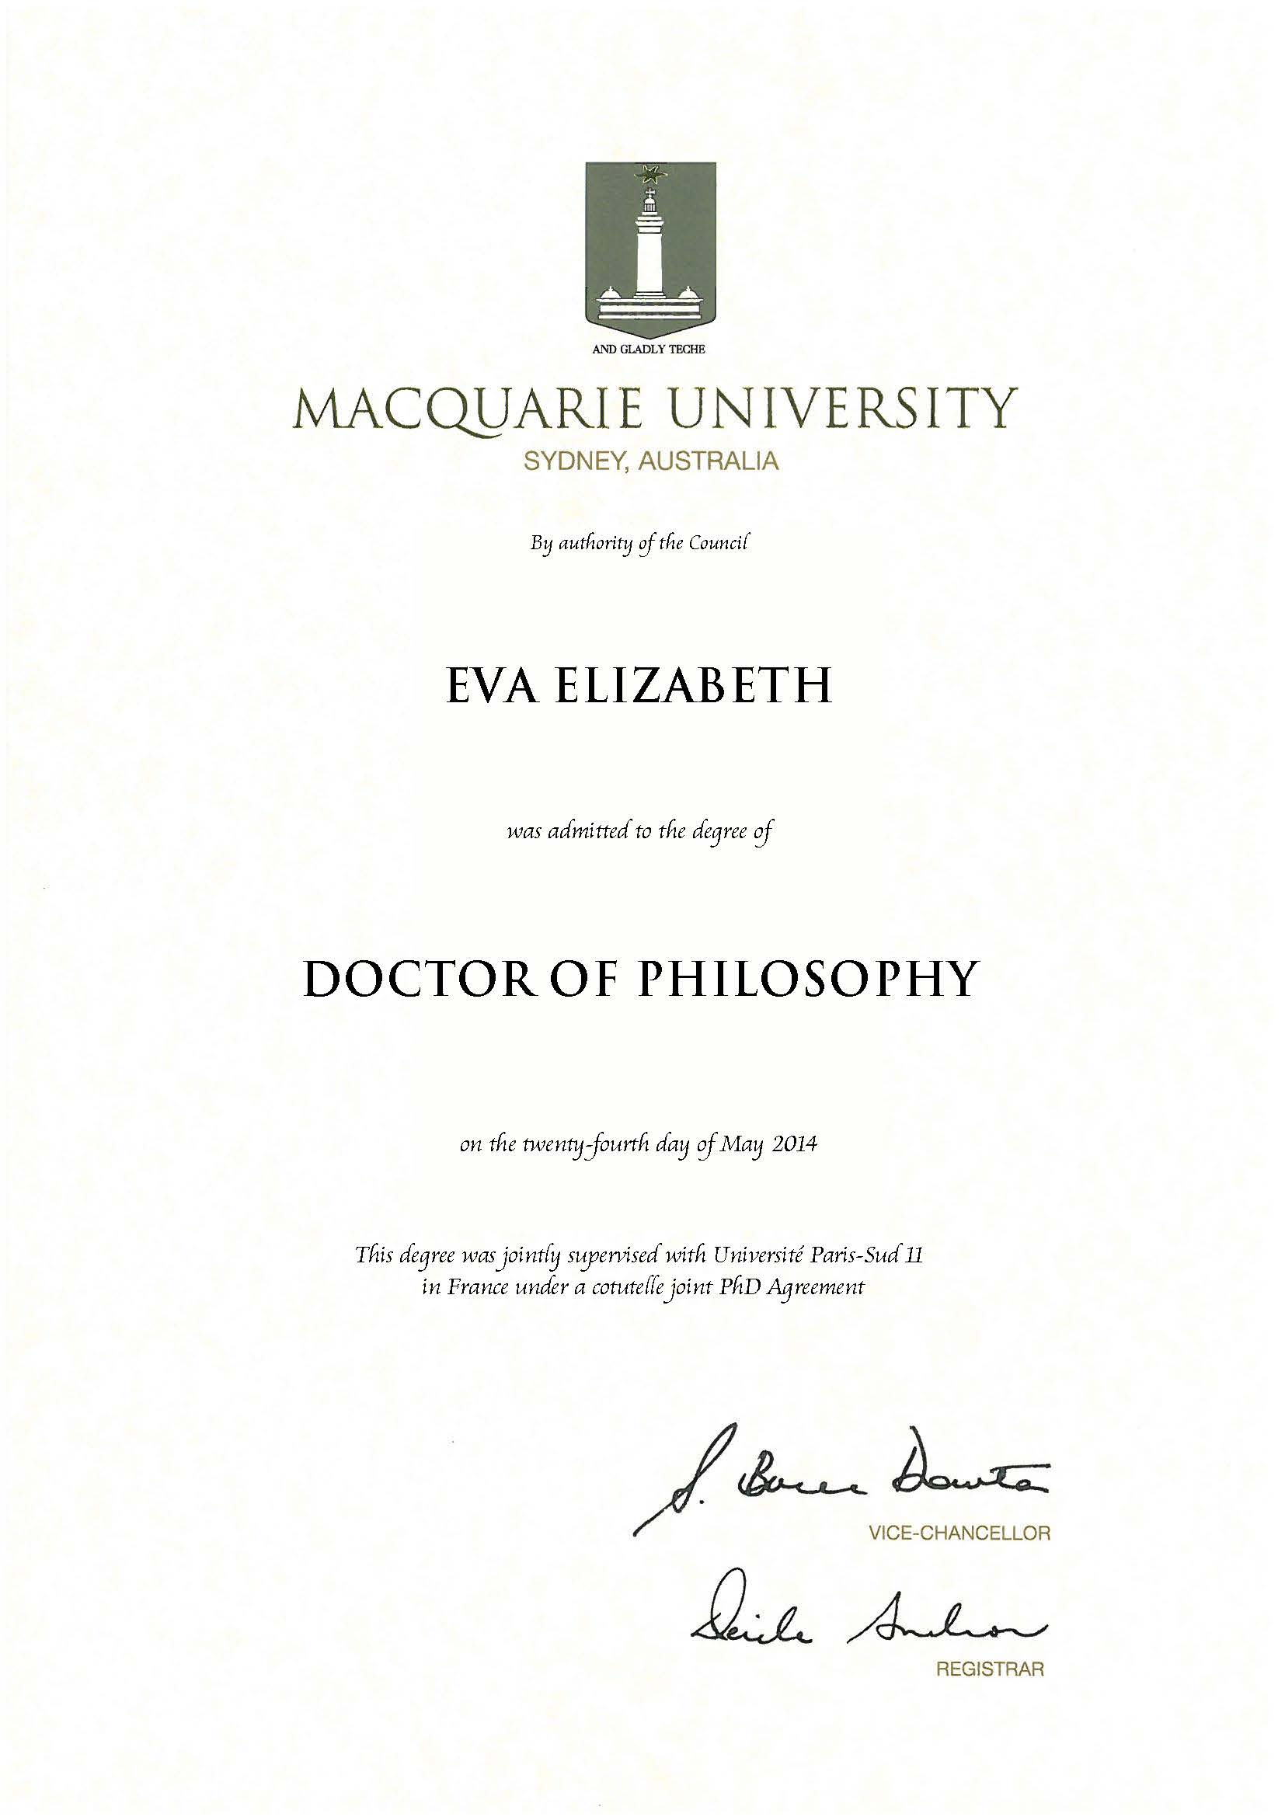
Example of Cotutelle Testamur

Slide 13
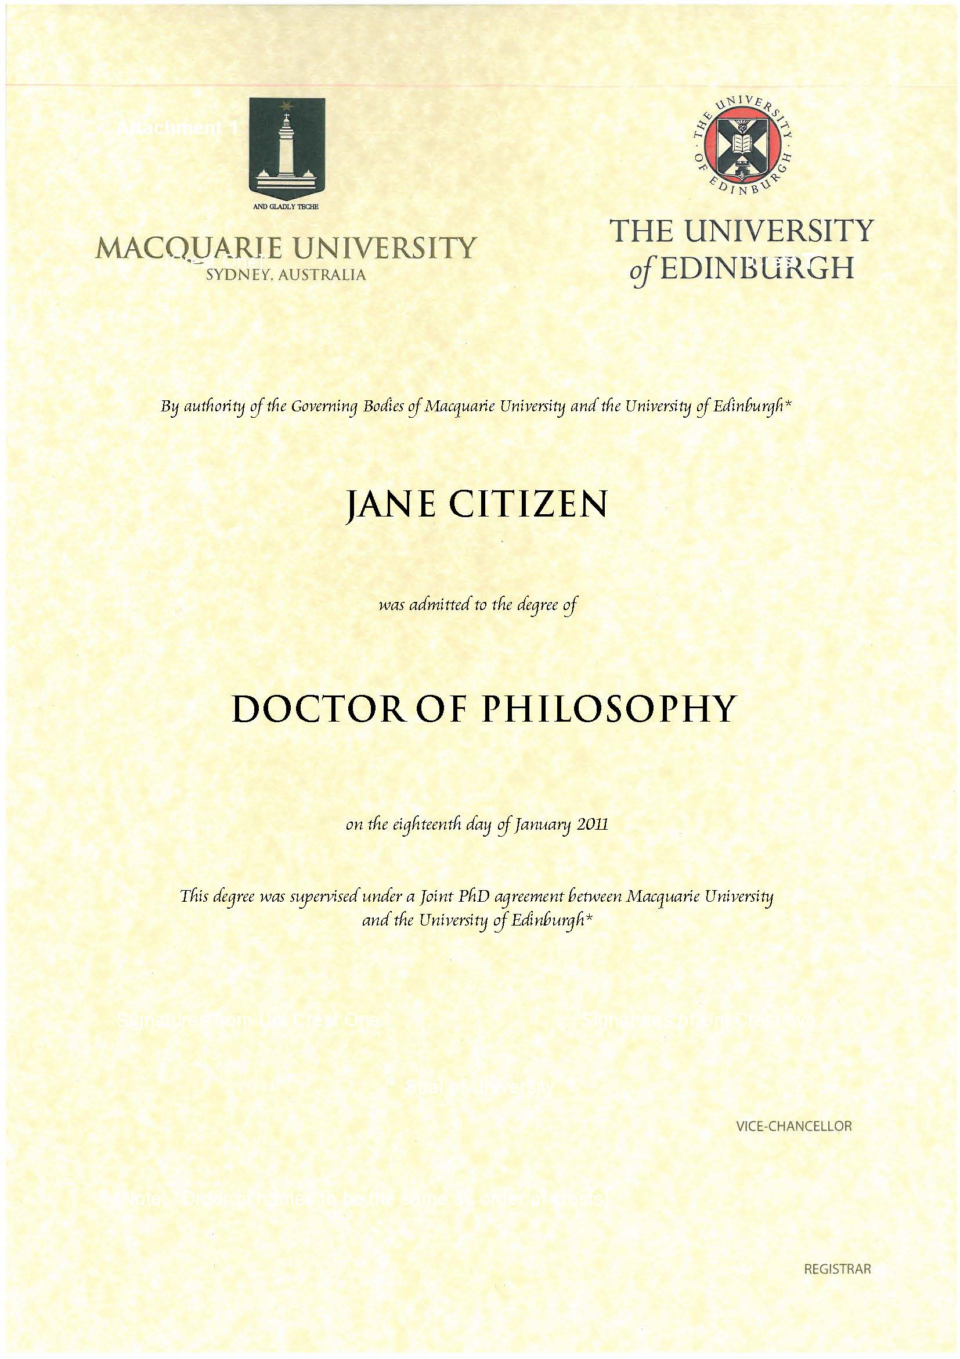
Example of Joint PhD Testamur

Slide 14
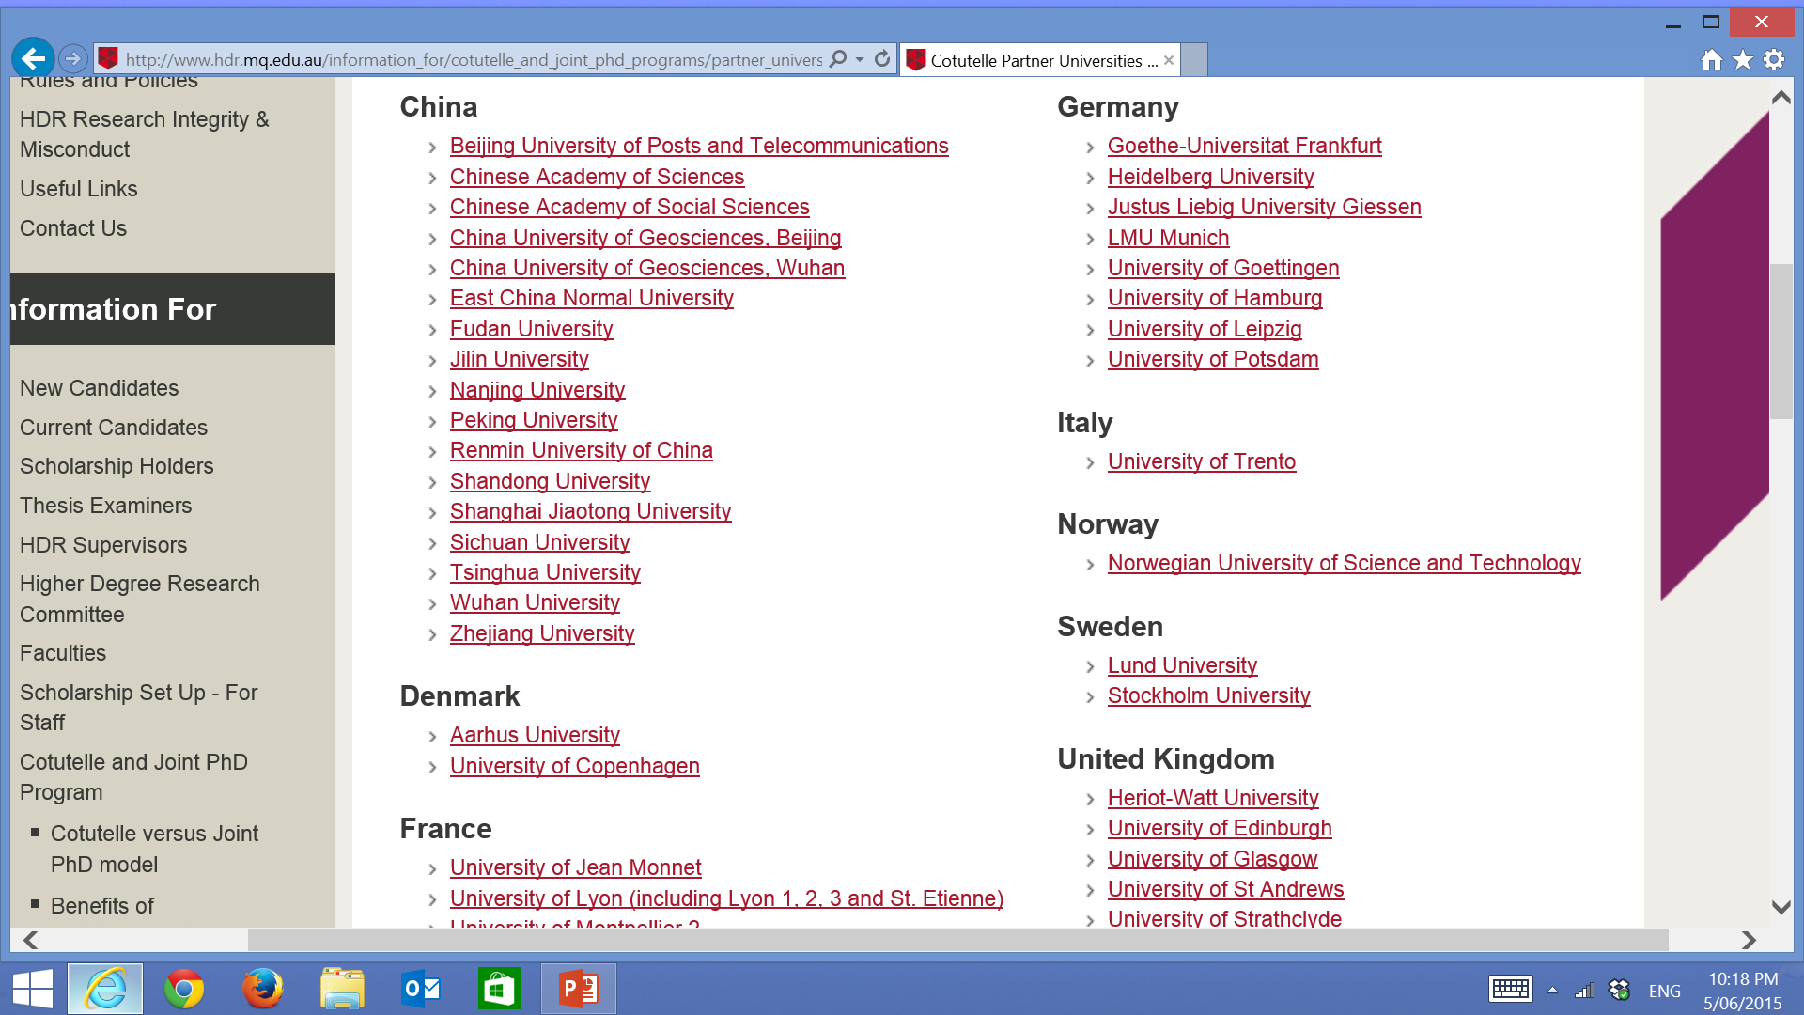

Slide 15
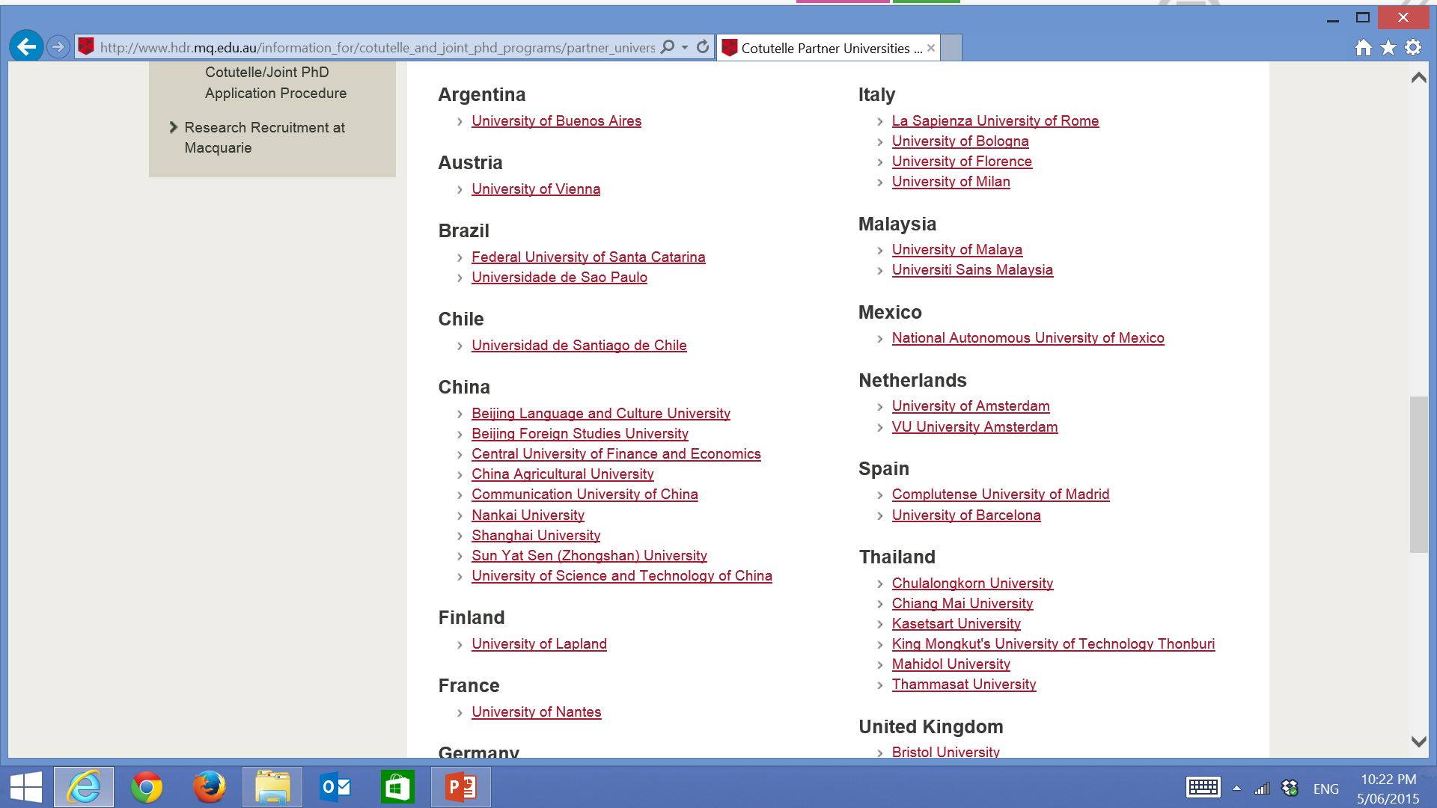

Slide 16
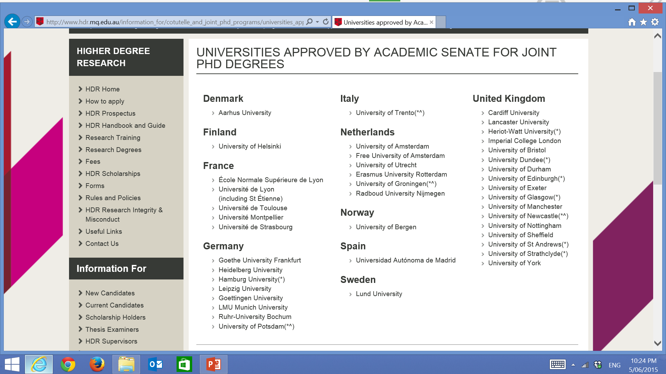

Slide 17
Applications

Slide 18
Before the Application
Check the candidate meets our basic entry requirements
Check to see if they are likely to receive a Cotutelle/Joint PhD scholarship.
Is a joint supervision program suitable?
Do they have funding support from overseas uni?
Can they spend half their time at MQ and at the partner?
Ethics clearance/Research Conduct

Slide 19
Cotutelle Proposal Form
Key document in formulating the agreement for the candidate
Available on the HDRO Website
Supervisor to complete with assistance from the candidate and partner supervisor
Joint Enrolment can not exceed 36 months or be less than 24 months
Must be endorsed by the ADHDR
Is then reviewed by HDRO and if applicable, DVCR

Slide 20
Scholarships

Slide 21
Cotutelle & Joint PhD
FUNDING
Macquarie University Research Excellence
Scholarship (MQRES)
Return airfare from Australia-Destination Country
Tuition fees at MQ for up to 3 years
Stipend on MQ campus
Partner University
This will depend on the partner university. It can vary from a scholarships award,
receiving payments as an assistant researcher, funding from a research lab etc.

Slide 22
Cotutelle & Joint PhD
EXTERNAL FUNDING AGENCIES
Australia Award
Australian Research Council
National Health and Medical
Research Council AU
China Scholarship Council
Brazil SWB
EU Horizon 2020
Germany DAAD
Germany DFG
National Sciences Foundation US
National Institute of Health US
Research Council Canada
Vietnam VIED
Thai Government Scholarship (C9)
Malaysia Government Scholarship
Program
Indonesia Government Scholarship
Program
Peru PRONABEC
Columbia COLSCIENCES
Chile CONICYT (soon)
Mexico CONACYT
Uruguay ANII
Pakistan HEC (soon)
Kazakhstan Bolakshak (soon)

Slide 23
Contact
HIGHER DEGREE RESEARCH OFFICE
Catherine Schedlich
HDR Coordinator – International Research Training Partnerships
hdrcotutelle@mq.edu.au
+61 2 9850 7997
http://hdr.mq.edu.au/cotutelle

Slide 24
Master of Exchange
7 Step Management Framework

Slide 25
7 Step Framework
2. Faculty level groundwork on course equivalence and supervisor availability
3. Application Process
4. Faculty consideration/approval
5. HDRO consideration/approval/offer/enrolment
6. Pastoral Care
7. Capturing success stories/reporting/ongoing international partnership development
1. Institution level overarching agreements

Slide 26
Step 1
Institution level overarching agreements
a) Existing partners:
University of Potsdam, Germany
University of Heidelberg, Germany
University of Hamburg, Germany
University of Goettingen, Germany
Tel Aviv University, Israel
East China Normal University, China
b) Template Agreement - ongoing improvement (Handout) c) Administrative contacts with HDRO are key. Timeframes for agreement negotiations depend on these.

Slide 27
Step 2
Faculty level groundwork on course equivalence, supervisor availability
Academic ground work in advance helps mitigates risk of applicants getting stuck in the system
Benefits to the Faculty and academics - concrete project proving tangible research collaboration (like Cotutelle/Joint PhD)
Faculty contacts with the Faculty are key. Timeframes for agreement negotiations also depend on these

Slide 28
Step 3
Application Process
a) Partner institution specific templates and requirements to be completed b) The MQ application form on our website c) Overarching Process Map on our website (handout). We recommend students plan 2-6 months in advance (exchange with existing partner)

Slide 29
Step 4
Faculty consideration and approval
a) Decisions based on course and supervisor availability, workloads, timing etc. b) Timing of visit is important – hemisphere difference c) “Pure coursework” courses sometimes preferred by candidate – HDRO can assist to redirect enquiries to Macquarie International

Slide 30
Step 5
HDRO consideration, approval, offer, enrolment
a. Application considerations MQ Student system (AMIS) has been set up to manage enrolment of MRes exchange – both inbound and outbound CRICOS code 037297F, VISA (575) Non Award Visa considerations and support from HDRO b. Approval by Director HDRO
Offer letter from Operations Team HDRO

Slide 31
Step 5 Continued
MONEY!
Costs and Funding
- Tuition fee paid to home University (where applicable)
- Outbound exchange students are covered by University insurance for indemnity and additional travel insurance,
- Inbound exchange students must purchase additional travel insurance and OSHC
- Macquarie University scholarships for outbound Macquarie University MRes students as on our website
- Travel support opportunities to be available soon - Nathen Rhead memorial scholarship for travel in development (for outbound exchange)

Slide 32
Step 6
Pastoral Care
a) Collaborate collegially with Macquarie International- institution support services available e.g. accommodation b) Orientation and support from HDRO (Like Cotutelles/Joint PhD) c) Faculty support

Slide 33
Step 7
Capturing success stories, ongoing international partnership development
a) Students to be asked to provide short formal reports/ HDRO photoshoot for Marketing b) HDRO reporting against agreement clauses with Faculty input c) Institution-wide capturing of partnership activities, partnership development – ongoing

Slide 34
Finally…
Communication is Key!
Email:
exchange@mq.edu.au
Website: http://www.hdr.mq.edu.au/information_about/research_training_degrees/mres-exchange
FAQ: http://www.hdr.mq.edu.au/information_about/research_training_degrees/mres-exchange/faq

