Slide 1
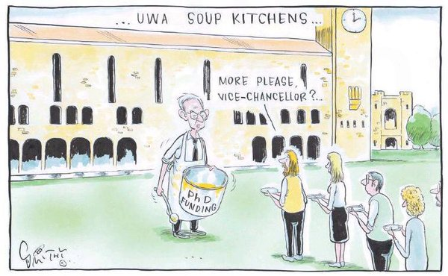
Scholarship ranking
MU
^
Notes:
Thanks Linda Beaumont!

Slide 2
Ranking PhD applications/scholarships
Outline of today’s workshop
Tracking applications and Biology’s new strategy
How the system processes an application
PhD entry requirements
How students get ranked and making sure you recruit competitive students
What you need to do as a potential supervisor
What we (Biology HDR) will do

Slide 3
Ranking PhD applications/scholarships
Tracking applications and Biology’s new strategy
Our new secret weapon:
Vince Repaci!
Notes:
Vince will keep an Excel file on all applications. He can ensure applications don’t get stalled. He will gather relevant ranking information into Excel.
Compliance can take a while—lots of back and forth with candidate. We need to monitor this process. There have been cases where applications have stalled and an e-mail reminder gets things going again.

Slide 4
Ranking PhD applications/scholarships
How the system processes an application (the 10 step program!)
Candidate submits application with supervisor approval
HDR: compliance check (visa, English proficiency, transcripts, referee reports, NOOSR, etc.)
HDR makes an initial assessment of candidate
HDR sends to FoSE HDR (Jane Yang)—does assessment check
Jane sends to Biology (Director of HDR) (Adam)
We send to supervisor with ranking
You send back to us
We send it back to Jane: compiles signatures, checks verifications, completeness
Jane sends to Tracy Rushmer (Associate Dean HDR)
Next steps: a.) scholarship allocated (non-competitive) or b.) competitive: FoSE ranking meeting, University ranking meeting (ranking signed off by Tracy Rushmer)
Notes:
6. depends on what type of application it is and/or the time of year. For example, when scholarships are made available unexpectedly, it can be first come first serve and there is no competitive process. NOOSR is standards of equivalency for foreign qualifications.

Slide 5
Does your student qualify for PhD-direct entry?
Does student have MRes equivalence for PhD admission?
Typically 2 yrs but can be less
At least 50% research
Thesis length typically 15-20 000 words but can be less
Take note: 50% research is gauged on credit hours/points by HDR and may not be accurate. You can make a case.

Slide 6
Does student qualify for PhD direct entry?
No
Yr 2 Mres + PhD bundle
Allocate publication & elevate to PhD entry
Yes
Happy days!

Slide 7
The trade-off of elevating a candidate into direct entry
No double dipping
Rank may be lower and candidate may fall below threshold
Good news: not as bad as before because publications now count less and academic record counts more
A good idea for first come first-serve or allocated scholarships but not always a good idea in competitive rounds (consult with HDR committee)
Notes:
This means that if you allocate, for example, a publication to get them into the PhD that paper cannot be used (again) to rank them.

Slide 8
Four standard criteria
A = References
B = Academic performance and thesis results
C = Peer-reviewed outputs or other evidence of peer-reviewed
research activity
D = Merit-based scholarships, prizes and awards
NOMINAL RATING = [A + (Bx4) + C + D] / 7
Decimal places matter!
Maximum score is a 5, cut-off for IPRS/iMQRES in 2015 (i.e. 2016 start) was 4.14
To be competitive a candidate needs at least 4.0 or 3.0 for domestic students (APA)
This does not apply for first-come first-serve rounds/allocated scholarships

Slide 9
References
How does this applicant compare to others that you have supervised? For example, top 10%
What are the applicant’s outstanding strengths in relation to their research capacity?
What can YOU do about this??
Notes:
Top two questions not used here, but can be referred to in next section (Academic performance and thesis results).

Slide 10
Academic performance and thesis results
4 times the weight of other criteria!
Comparisons across intuitions/countries can be tricky (we can help, NOOSA check by HDR)
What can YOU do?
What is MSc like? Look at that first and then
maybe BSc Hons, maybe BSc.
Check with applicant: how well did he/she rank in their class?
Notes:
To get a 5 is tough, basically has to win university medal. We scrutinize the transcripts to get this information. Class ranking not always available, in which case we would refer to supervisor’s ranking as extra information.

Slide 11
Peer review output
“Record of publications” = 3+
Any research activity (publications, prizes etc.) which is used to meet candidature equivalence in Stage 1 cannot be used again towards scholarship rating in Stage 2.
International conference presentations count!! = 4
What can you do?
Paper in review? – check if accepted. Get acceptance letter.

Slide 12
Merit-based scholarships, prizes & awards
What can you do?
Double-check whether candidate has any prizes or external conference travel awards (=5). Not uncommon in biology.
Upload evidence.

Slide 13
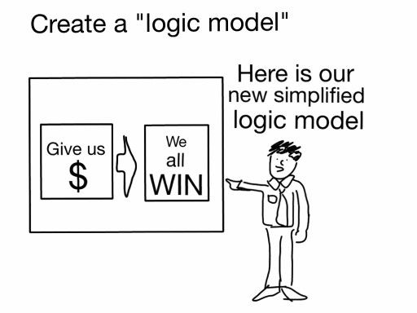
If you have an applicant with a low score but proven track-record (i.e. publications)…
Exceptional case
Talk to HDR committee
We have been successful at
this in the past!

Slide 14
What you need to do as a supervisor
Step 1: Are you bale to login to the eApp portal? Unfortunately everyone has to request permission for access:
Please go to onehelp.mq.edu.au then click Request Something > Academic & Student Management > HDR Student Admission - AMIS Cloud
In the ticket, write you full name, OneId and email
You are requesting access to be able to process HDR applications

Slide 15
What you need to do as a supervisor
Follow the “supervisor help card”:
Approved thesis title
Field of Research (FOR) Codes
Confirm approval of supervisor by department
Check ranking by DHDR and/or meet with us to discuss
Note: we can’t inflate a ranking! Sorry…
Check prizes/travel awards with student
Stay in contact with student: check status of in-review papers
Notes:
Supervisor help card is a Word file of instructions. Can be e-mailed to you by Vince or anyone on HDR committee. It’s a detailed how to book.

Slide 16
What we will do
Help you vet students before the application process
Make sure your applicant’s application does not get bogged down
Do the actual ranking and review this with you
Make the case for your student in the ranking meeting
In exceptional cases we will help you make the case for a discretionary scholarship

Slide 17
Take note!
The 2017 International Postgraduate Research Scholarships (IPRS/iMQRES) round is now open and advertised on the Higher Degree Research Office web pages: http://www.mq.edu.au/research/phd-and-research-degrees/scholarships/scholarships-for-international-candidates
Closing date: 31 July 2016
Faculty meeting 23 September
APA closing date 31 October 2016

Slide 18
More good news!!
2016 MID-YEAR DOMESTIC SCHOLARSHIP
OPPORTUNITIES STILL AVAILABLE
Macquarie University has a mid-year Scholarship allocation of
25 MQRES (for Domestic) scholarships available for newly
commencing PhD candidates only.
These scholarships will be offered to the first approved 25
domestic PhD offers. Value: $26, 288

