Slide 1
Department of Biological Sciences
Dept meeting 2nd April 2019
Agenda
HoD news
Sustainability – Sam Newton
WHS – Simon Griffith
Research – Andrew Barron
L&T – Drew Allen
HDR – Grant Hose, Culum Brown
Outreach – Matthew Bulbert
Committee Budget/Purchasing Pilot/New Credit Card Policy – Sharyon
We acknowledge and pay respect to the Traditional Custodians and Elders of the lands on which our university is located

Slide 2
HoD news
ERA results
Well-above world standard (5)
06 Biological Sciences
0602 Ecology, 0603 Evolutionary Biology, 0604 Genetics, 0607 Plant Biology and 0608 Zoology.
05 Environmental Sciences
0501 Ecological Applications and 0502 Environmental Science and Management
07 Agricultural and Veterinary Sciences
Above world standard (4)
0605 Microbiology

Slide 3
HoD news
Enrolments
S1 enrolments - undergrad
2015 | 2016 | 2017 | 2018 | 2019
2484 | 3032 | 2948 | 2920 | 2831
S1 enrolments - Postgrad
2015 | 2016 | 2017 | 2018 | 2019
42 | 100 | 149 | 187 | 232
OUA | BIOX108 | 0 | 0 | 0 | 18 | 97
 | BIOX122 | 0 | 27 | 42 | 53
 | BIOX260 | 94 | 71 | 0 | 20
BIOL108 -17%
BIOL114 +10%
BIOL116 +11%
BIOL206 -10%
BIOL228 +20%
BIOL235 +18%
BIOL257 -11%
BIOL262 -14%
BIOL328 +24%
BIOL376 +23%
BIOL861 +36%
BIOL875 +35%
HDR | BIOL700 (Mres Year 1) | 9 | 14 | 18 | 27 | 20
 | BIOL899 (MRes year 2) | 23 | 18 | 20 | 34 | 28
 | BIOL995 (MPhil) | 0 | 0 | 1 | 1 | 1
 | BIOL990 (PhD) | 29 | 29 | 79 | 90 | 84

Slide 4
HoD news
Academic staff PDRs and workloads completed for 2020
 | Level A | Level B | Level C | Level D | Level E | total
female | 0 | 2 | 3 | 4 | 3 | 12
male | 0 | 1 | 5 | 8 | 9 | 23
Overall: standard 40:40:20 academics
Research range 33-80, average = 52
Teaching range 33-53, average = 40
Service range 19-52, average = 29

Slide 5
HoD news
Workload review
Call for expressions of interest for working party
Pressure on teaching labs and teaching resources
Be mindful of tech and casual staff time
Teaching labs: 3 pracs per day from 2020
Budget
FSE budget still in process of repair
Casual budget under pressure
Two positions only for release in 2020 (Evolutionary Genomics, Vertebrate Physiology)
Teaching gaps – S2 2019: BIOL247, BIOL115; 2020: BIOL391, MedSci Foundations and Capstone units

Slide 6
HoD news
Aquatic Facility – still in planning with Property
Biosciences building – CERs still undergoing testing
W19F – backfill planning, work will start when Taylor’s group moves out
Translational Biosciences proposal

Slide 7
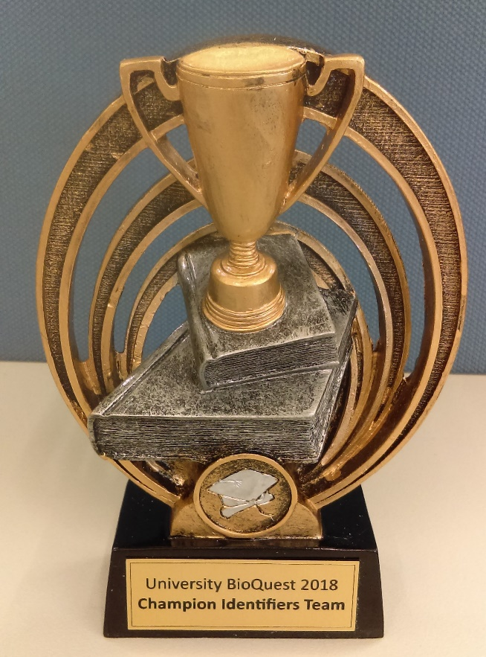
University BioQuest April 2018
Compete against other universities to win prizes!
The University BioQuest is an international competition against other universities to record sightings of native plants and animals.
Throughout April, submit sightings, on or off campus, of ‘wild’ animals, fungi and plants.
The rarer your find, the higher your score.
Your efforts could help us claim the Champion Spotters Team Trophy! There are also points for providing correct identifications through QuestaGame’s Bio-Expertise Engine (bee.questagame.com).
Last year we won the Champion Identifiers Team Trophy

Slide 8
University BioQuest April 2019 https://universitybioquest.com
How does it work?
Step 1. Download the app (through the App Store for iPhone, or through Google Play for Android)
Step 2. Register with QuestaGame https://questagame.com/
Step 3: Join the Macquarie University Team https://universitybioquest.com
Step 3. Take a photo and upload to the app. Location is automatically recorded. Sightings are verified by a team of experts.
Step 4. Take more photos and go in the running for great prizes and awards.

Slide 9
Sustainability Working Group
The Sustainability Working Group had its first meeting on 25th March.
Following distribution of the draft Vision for Sustainability, we have made minor adjustments. The Vision for Sustainability for Biology is:
We are a diverse, vibrant community, united by our interest and curiosity for living systems. We create a better future through collaboration, accountability and sharing of knowledge and resources.
We achieve this by:
Embedding environmental sustainability in our curriculum
Reducing waste and energy emissions from our operations
Having an engaged, integrated and caring community
Our next focus is to achieve Gold Accreditation in Sustainability for the department
Contact Samantha Newton samantha.newton@mq.edu.au if you would like to be involved.

Slide 10
WHS Update
Inspections – Lab and Offices
•Will take place through April, please prepare now
•Personal items
•Incentives for timely completion of corrective actions
Lab Essentials
•Needs to be completed by all academics and HDR students (access to labs will be restricted if not done)
Out of Hours Policy –
•Sharyon is reviewing all groups with animal care responsibilities
•There will be a process for everyone else soon, but it will involve activity risk assessments for all lab activities
Drones
•There will be a new policy released soon (Nick Harris is our contact)

Slide 11
Research stuff
Faculty visiting researcher scheme - next round opens May 2. Details available MQ: staff: intranet: FSE: awards
MQRF round opens mid April. Enquiries possible now. Each applicant will need dept support.
Faculty wants to bring large conferences to MQ – any ideas?

Slide 12
Learning and Teaching Curriculum Update
The department has requested that we teach out pre-2020 versions of the Human Biology major and the Bachelor of Medical Sciences
All other programs will be transitioned to the new curriculum using a hybrid model
Rules for this transition will need to be finalized within 50 days

Slide 13
Learning and Teaching Curriculum Planning Day May 3
Teaching clusters
Unit reviews
Unit convenor model – move towards team-based teaching
Practical class schedule and delivery – due to cuts to the casual budget, we need to review which units run cost-effectively, and whether those models of delivery can work across more units

Slide 14
MRES 2019
Yr 1 - 21 Students
Yr 2 – 22 starting Jan 2019 (submitting from 14/10/19)
5 started Jul 2018 & submitting from 20/4/19
Year 1 stipend (4k) now only for FT domestic students with averages >75 (previously all domestic FT students)
Year 2 scholarships ~30% success, cutoff mark for stipend ~89

Slide 15
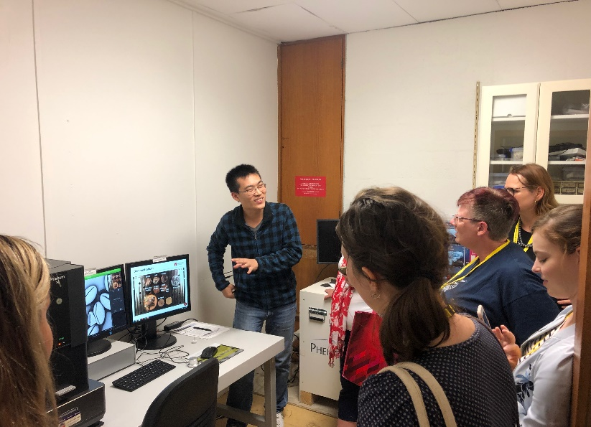
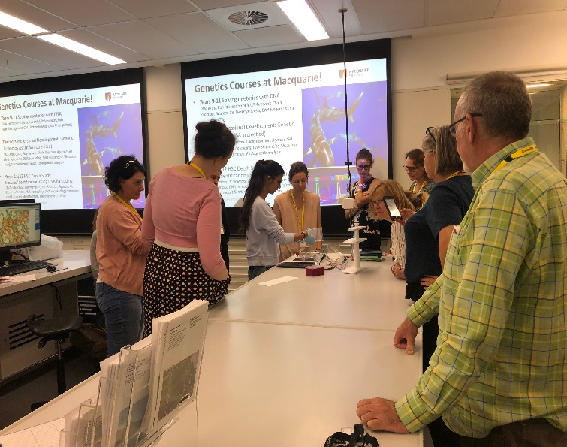
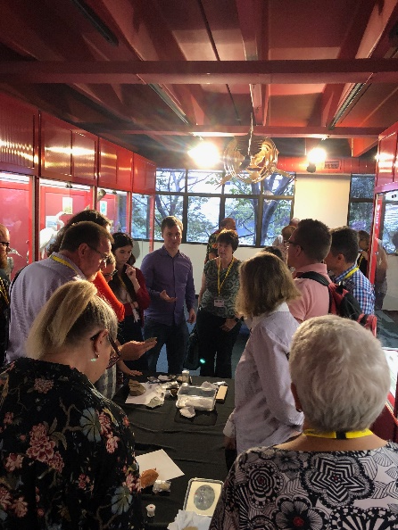
Science Teachers Association Conference NSW
Big contribution this year:
Four workshop tasters:
Microscopy unit
Team Paleo: Learning from history of organisms
Team Ecology: Introduction to ecological methods and applications
Team Conservation: Solving mysteries with genetic technologies
Lizzie Lowe did a keynote
Stall – Genetics PD, 4 Depth Studies = Genetic technologies, Adaptations, herbivory and fresh water ecology

Slide 16
Upcoming
Biology Work Experience:
Next week – we need more contributions
April 8th – 12th
Mol Sci
Minibeast Day
Abbotsleigh 1st year primary girls
April 10th
Macquarie in a Day
April 17th/18th = 120 kids partnered with Mol Sci
Inspiring Australia: Library talks
Good opportunity for ECR’s, PhD’s, new staff
https://inspiringnsw.org.au/2019/03/04/participate-in-a-library-talk/
Fill in form by April 5th

Slide 17
Committee Budget
Purchasing Pilot
New Credit Card Policy

