Slide 1
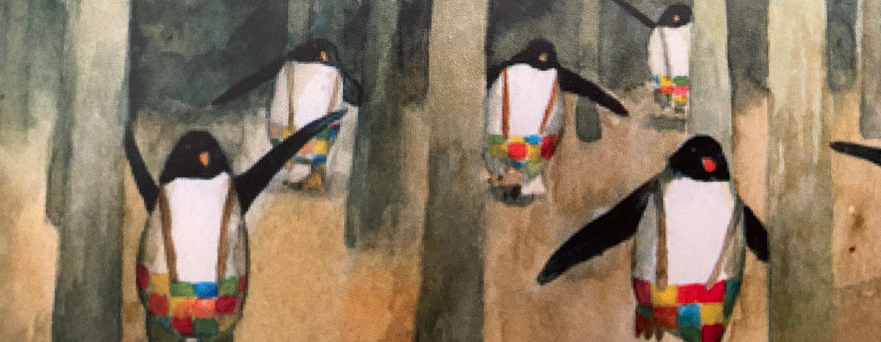
Get your Rainbow on!
Biology’s IDAHOBIT
Morning Tea
10am Wednesday May 13
Zoom link to follow

