Slide 1
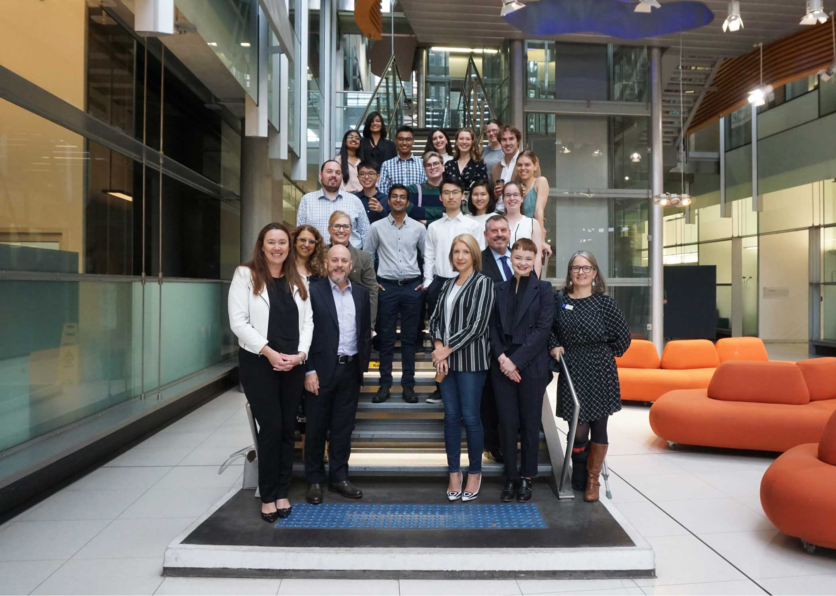
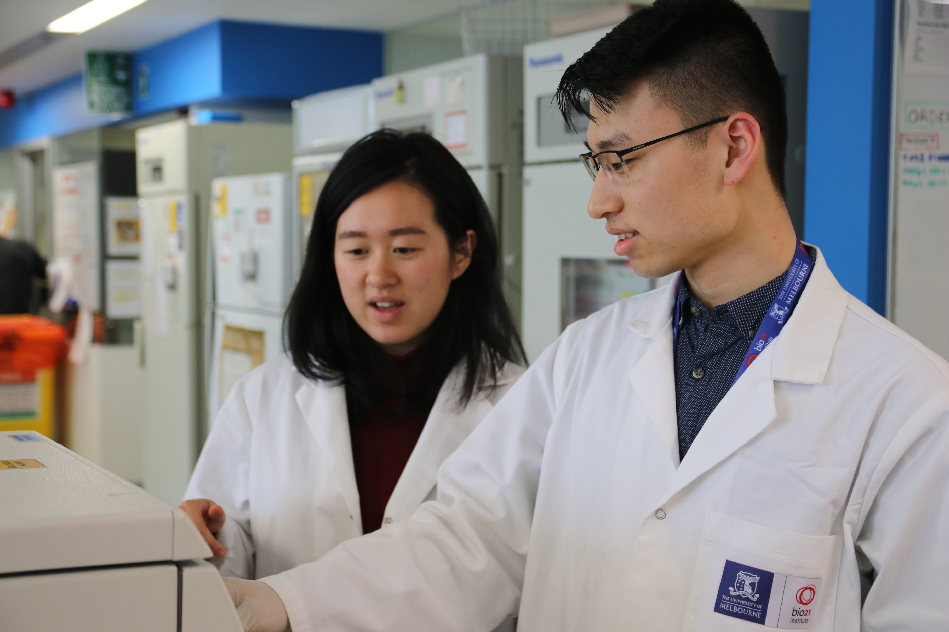
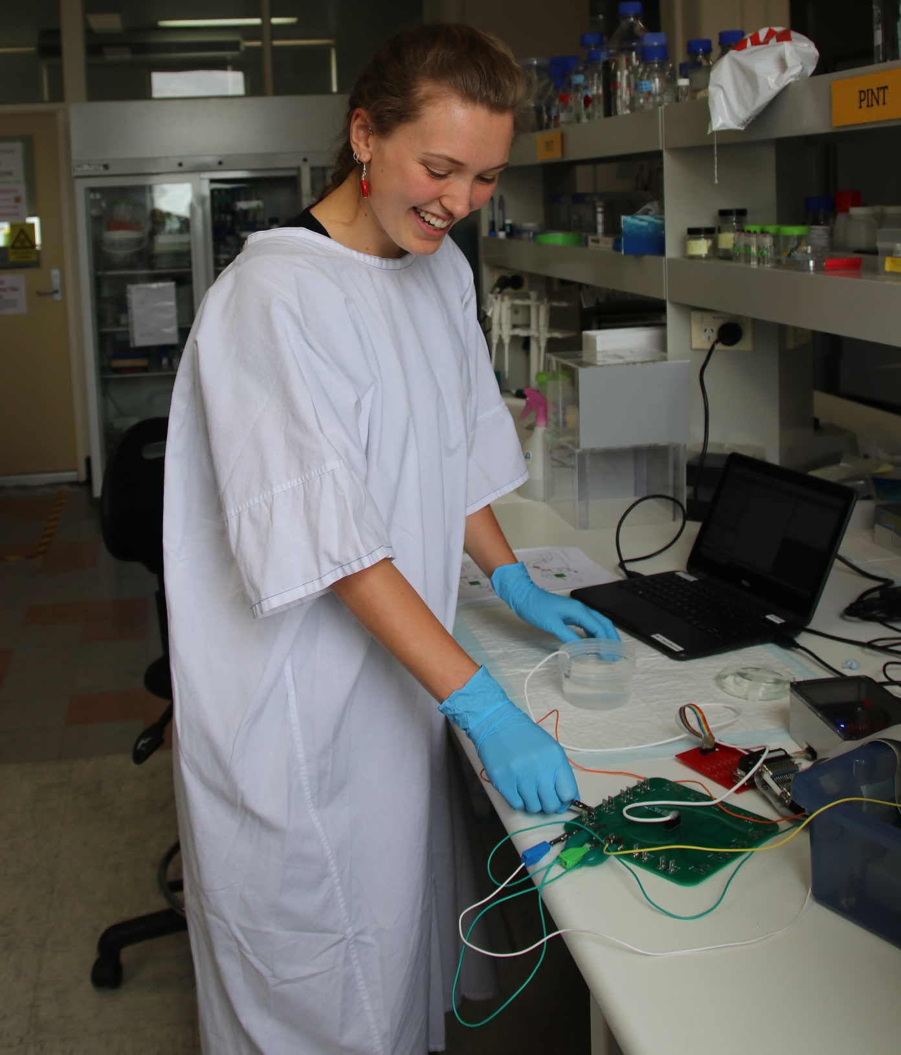
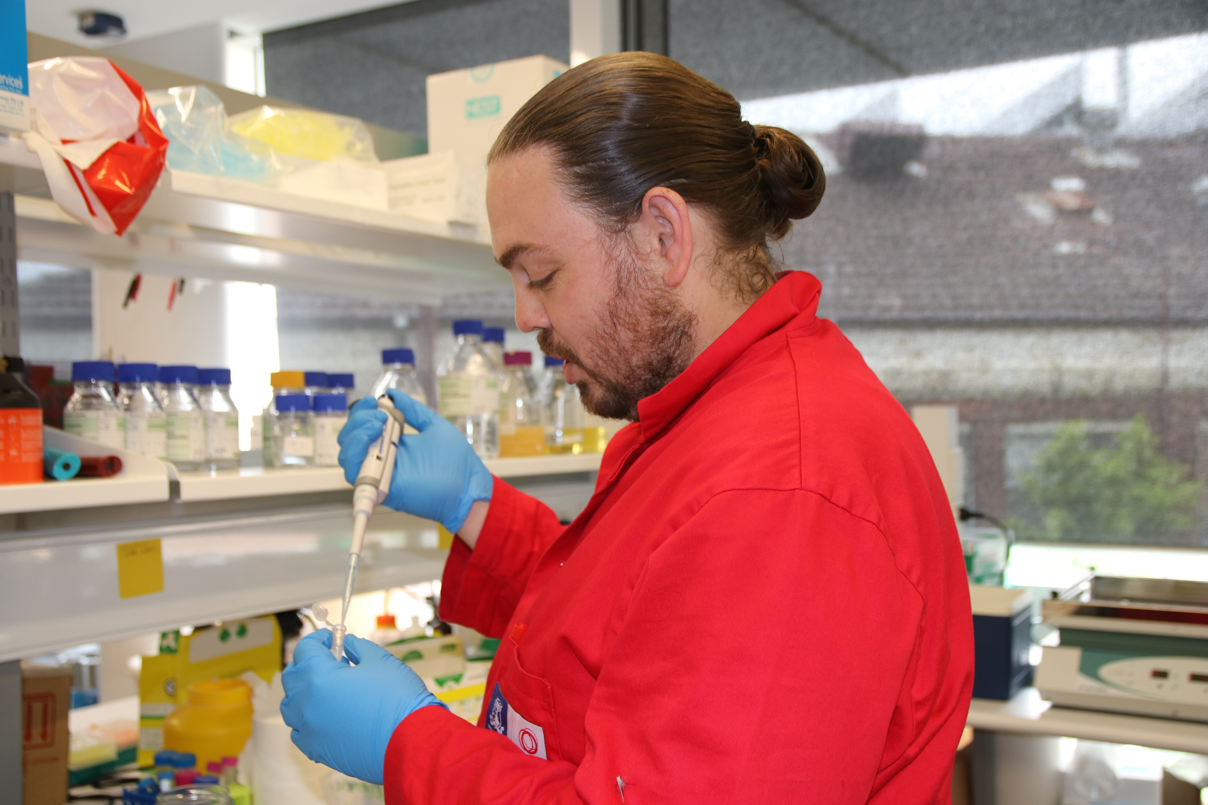
Are you a second year student and have a passion for scientific research?
You are invited to join the Amgen Scholars Program 4 January – 26 February 2021 at The University of Melbourne
Experience full-time research in one of our world class laboratories over 8 weeks, fully funded.
Benefits:
Up to $3600 stipend payment
Travel, accommodation, food and excursions all provided
Join a community of exceptional scholars from across the globe
Applications close 30 August, 2020
For more information visit: amgenscholars.research.unimelb.edu.au
Enquiries: amgen-scholars@unimelb.edu.au

